Slide 1
SMP Stochastic Modelling and Processes
Lecture 5
Recap Chapter 5
Point Estimation and sampling

Slide 2
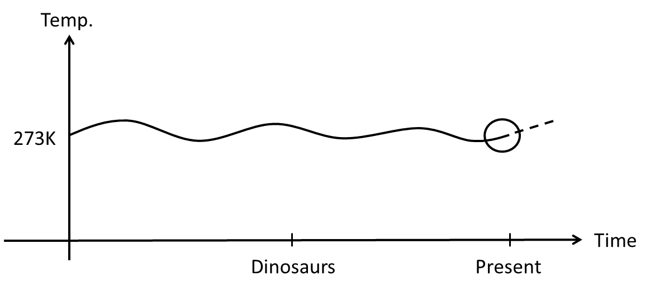
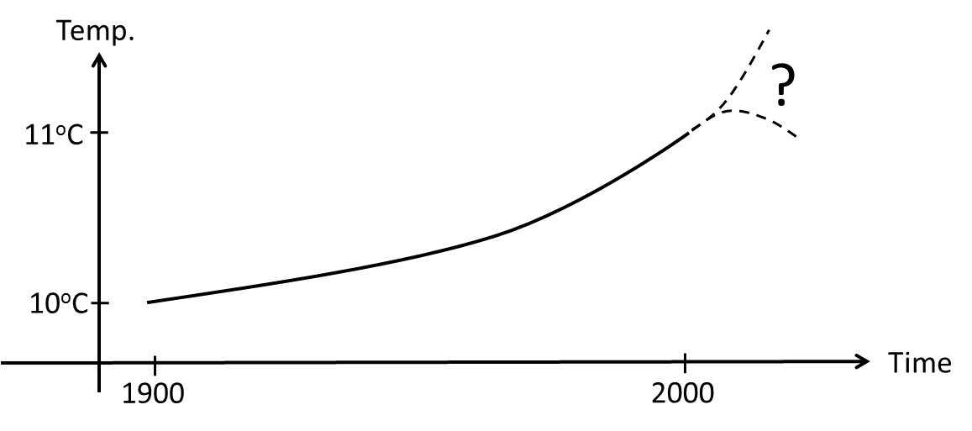
Descriptive Statistics
Descriptive statistics summarizes data from a sample using indexes such as the mean or standard deviation.
Descriptive statistics also includes tables, graphs, etc.
Not statistics
Climate changes
Extra-polation

Slide 3
Inferential Statistics
Inferential statistics infers predictions about a larger population than the sample represents.
It uses patterns in the sample data to draw inferences about the population represented, accounting for randomness.
These inferences may take the form of:
answering yes/no questions about the data (hypothesis testing)
estimating numerical characteristics of the data (estimation)
describing associations within the data (correlation)
modeling relationships within the data (regression analysis).

Slide 4
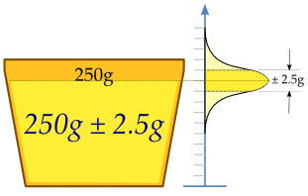
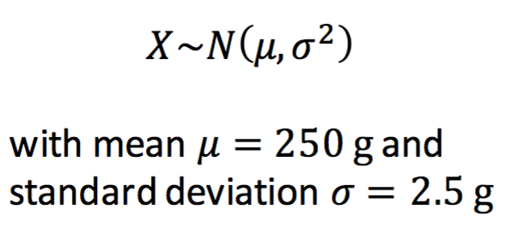
Cup Example
A machine fills cups with a liquid, the content of the cups is 250 grams of liquid.
The machine cannot fill with exactly 250 grams, the content added to individual cups shows some variation, and is considered a random variable, 𝑋.
If the machine is adequately calibrated, 𝑋 is normally distributed

Slide 5
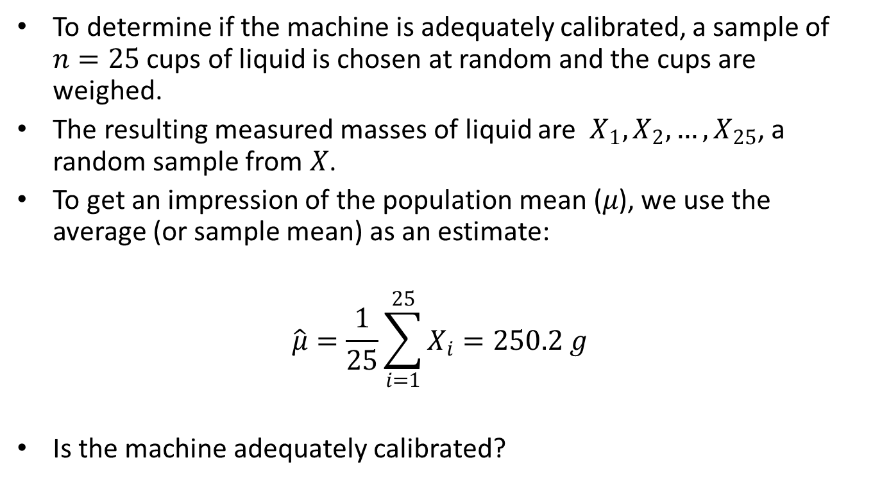
Cup Example
ONE sample of the population!
Population — All cups for all times
Sample mean is NOT the expected value (true mean)!
^ means an estimator of the true polulation value

Slide 6
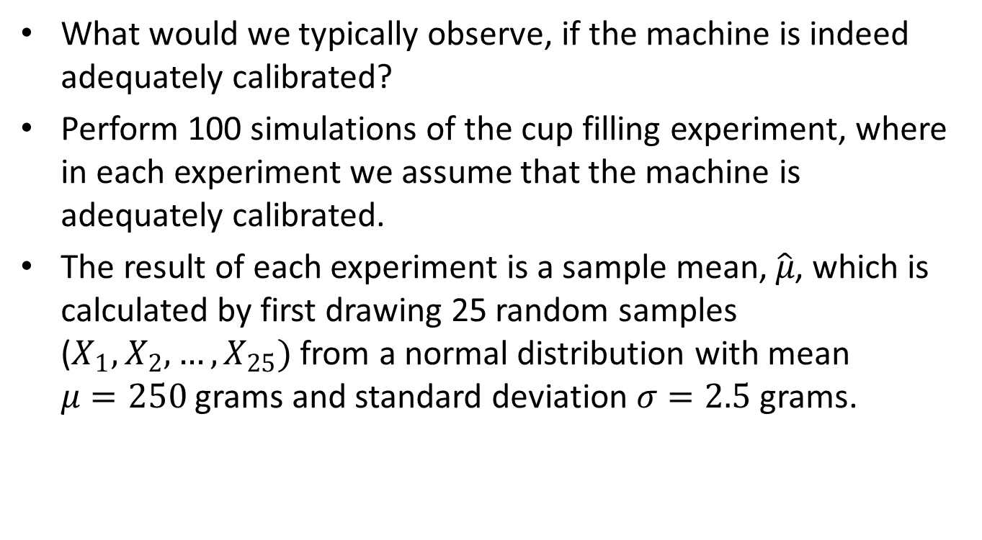
Cup Example
100 samples of the population – fx. in Python
.
Notes:
import numpy as np
X=np.random.randn(25)*2.5+250
print(X)
print(np.sum(X)/25) # np.mean()
#might be meaningfull to plot it..

Slide 7
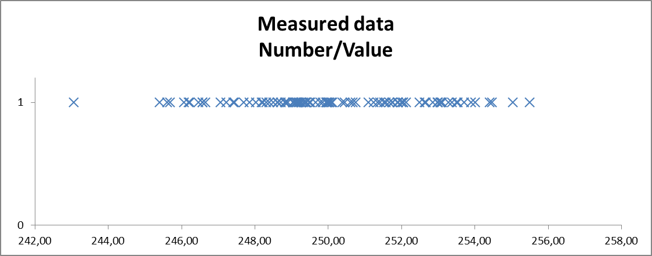
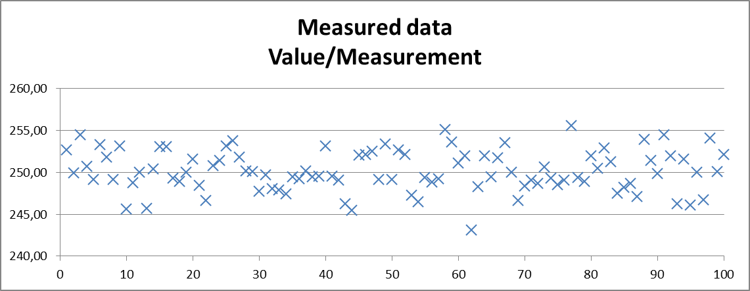
Histograms
Presentation of data

Slide 8
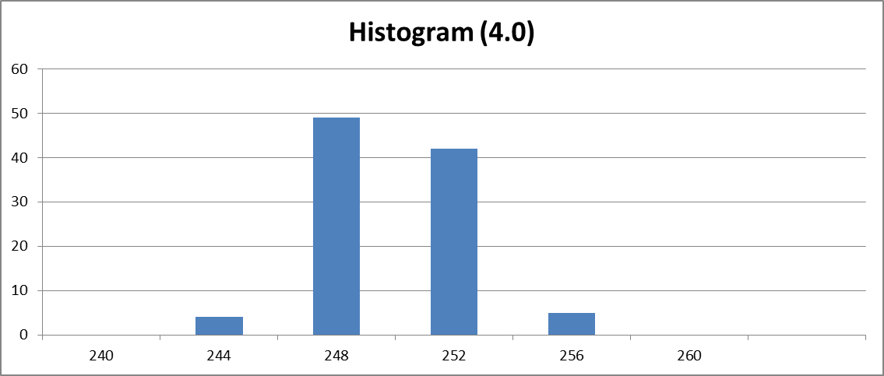
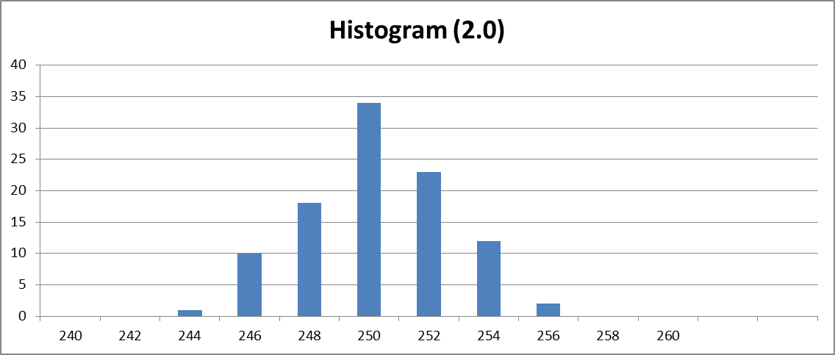
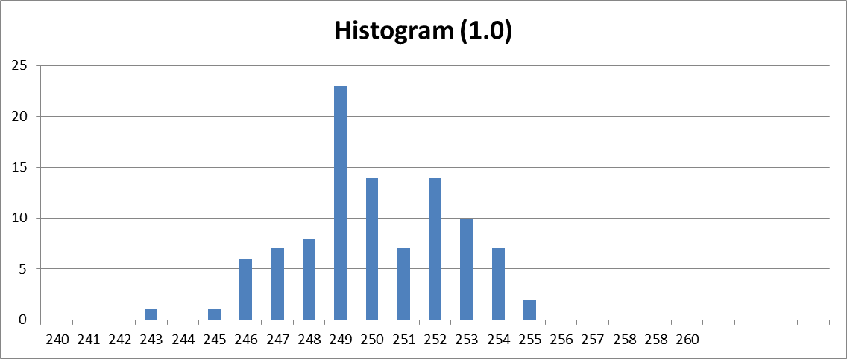
Histograms
Grouping of data
Interval
Center
Freq
Notes:
import numpy as np
N=25
X=np.random.randn(N)*2.5+250
print(X)
print(np.sum(X)/N) # np.mean()
import matplotlib.pyplot as plt
plt.hist(X, bins=[240,245,250,255,260])
plt.show()

Slide 9
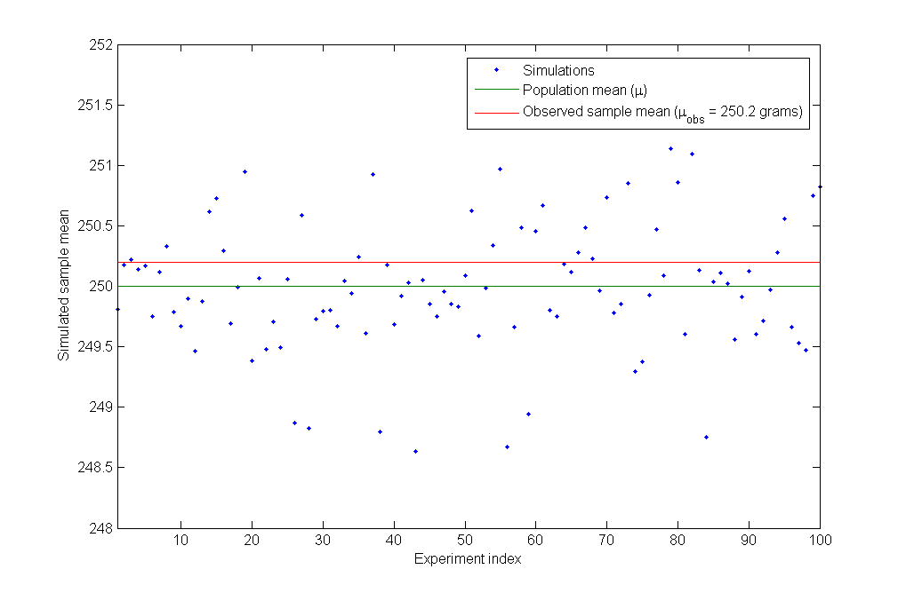
Cup Example
What would we typically observe, if the machine is adequately calibrated?
28 of the 100 simulated values are more extreme than our observation.
Observed value
Theoretical value
Conclusion: If the machine is adequately calibrated, then due to random variation, we will often observe a sample mean (or average) that is more extreme than the actually observed value of 250.2 g.

Slide 10
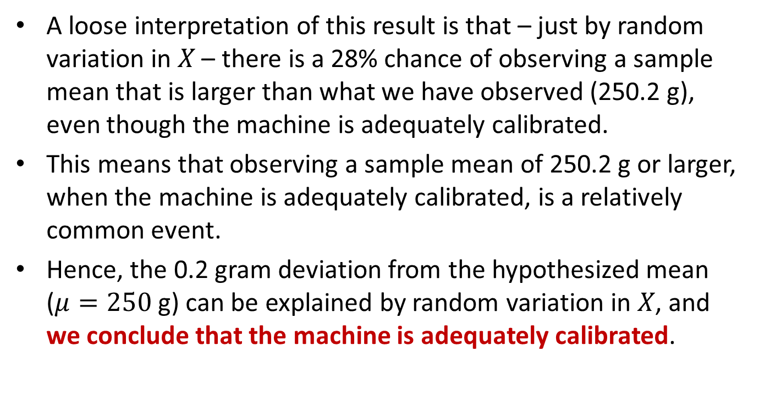
Cup Example
it is likely that

Slide 11
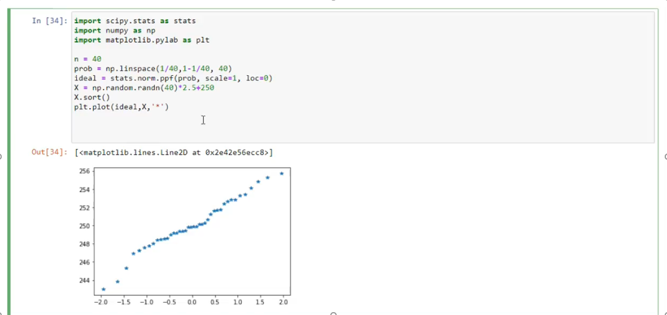
Probability Plot
stats.probplot(data, dist=stats.norm, plot=plt)
Notes:
Plottet for 2 different datasets.

Slide 12
Population
Key term
Definition 1 - Population
In statistics, a population is a complete set of items that share at least one property in common that is the subject of a statistical analysis.
Populations can be diverse topics such as “all persons living in a country” or “every atom composing a crystal”.
In the cup filling example, the population is “all cups filled by the machine”.

Slide 13
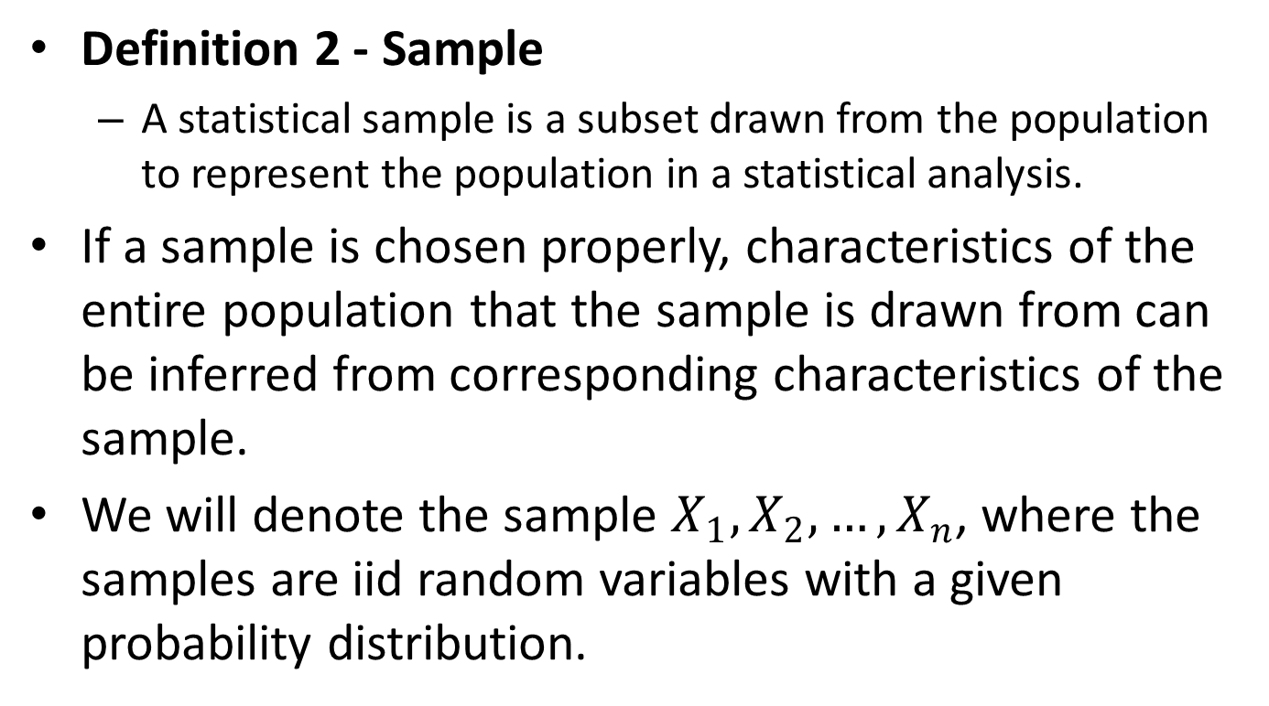
Sample
Key term

Slide 14
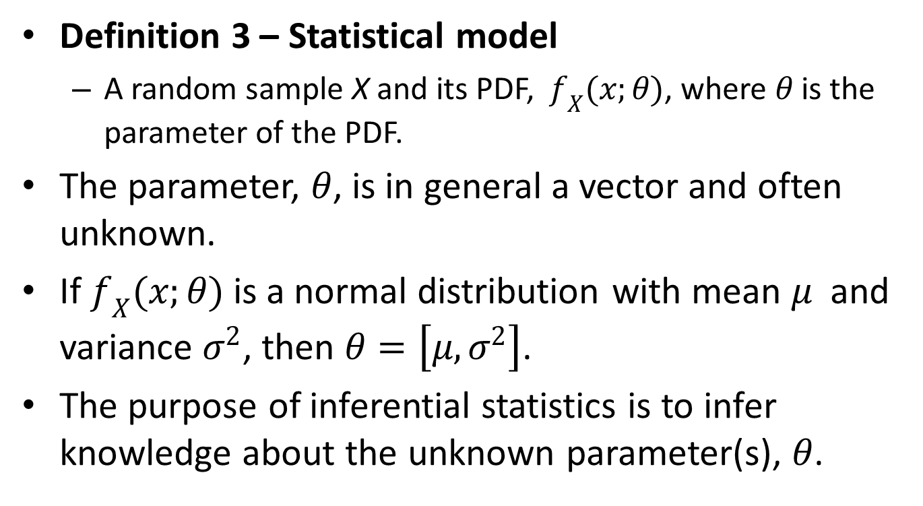
Statistical Model
Key term

Slide 15
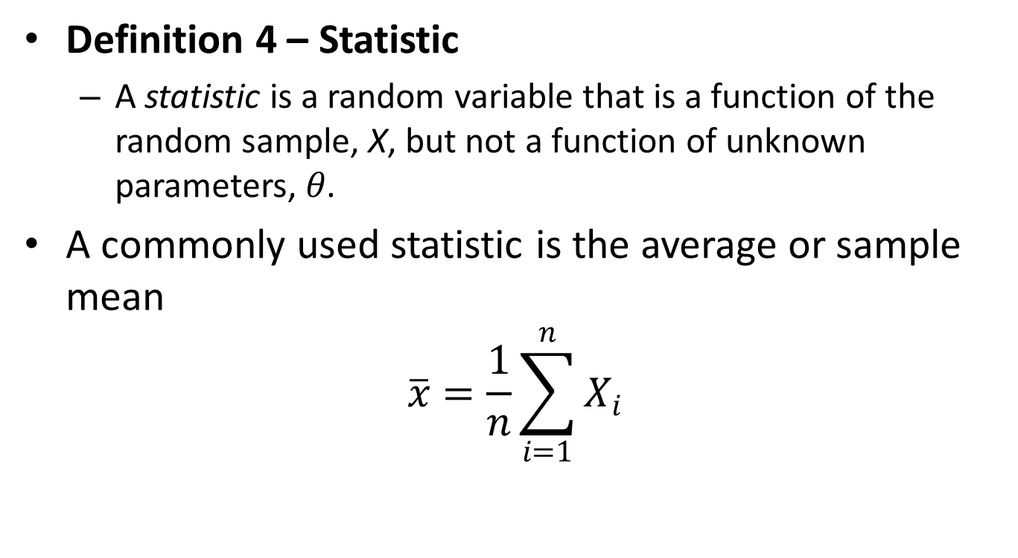
Statistic
Key term

Slide 16
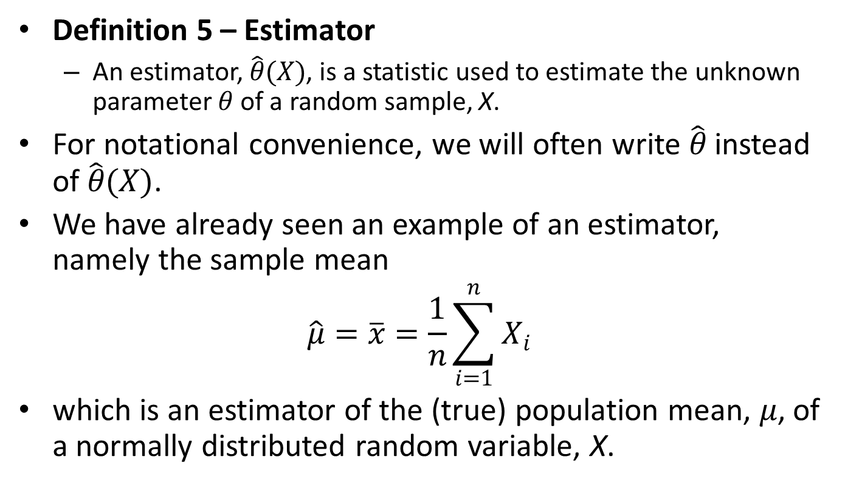
Estimator
Key term

Slide 17
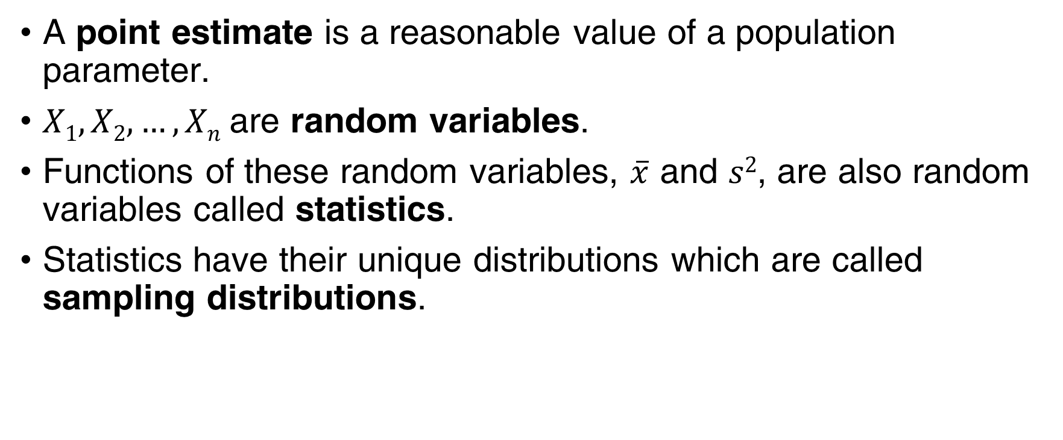
Point Estimation
A point estimate is a reasonable value of a population parameter.
$X1, X2,…, Xn$are random variables.
Functions of these random variables, $\overline{x}$ and $s2$, are also random variables called statistics.
Statistics have their unique distributions which are called sampling distributions.

Slide 18
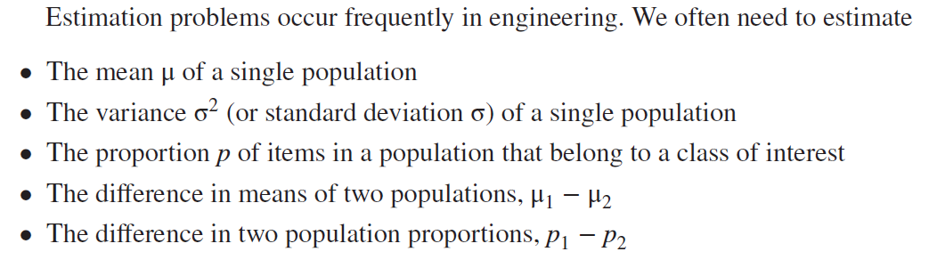
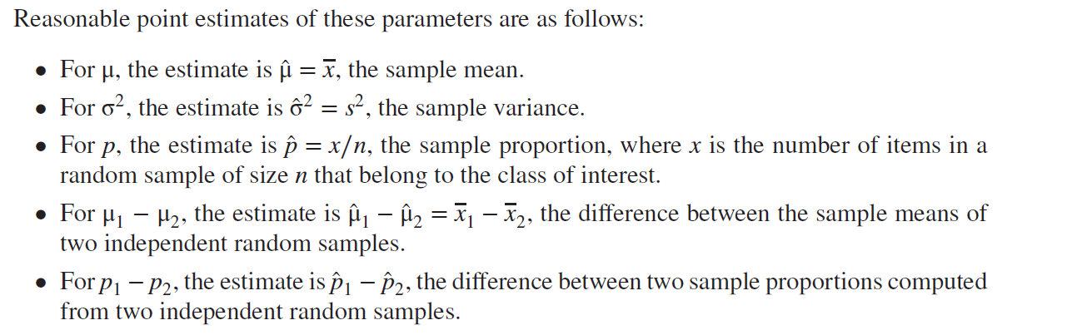
Some Parameters & Their Statistics
There could be choices for the point estimator of a parameter.
To estimate the mean of a population, we could choose the:
Sample mean.
Sample median.
Average of the largest & smallest observations in the sample.

Slide 19
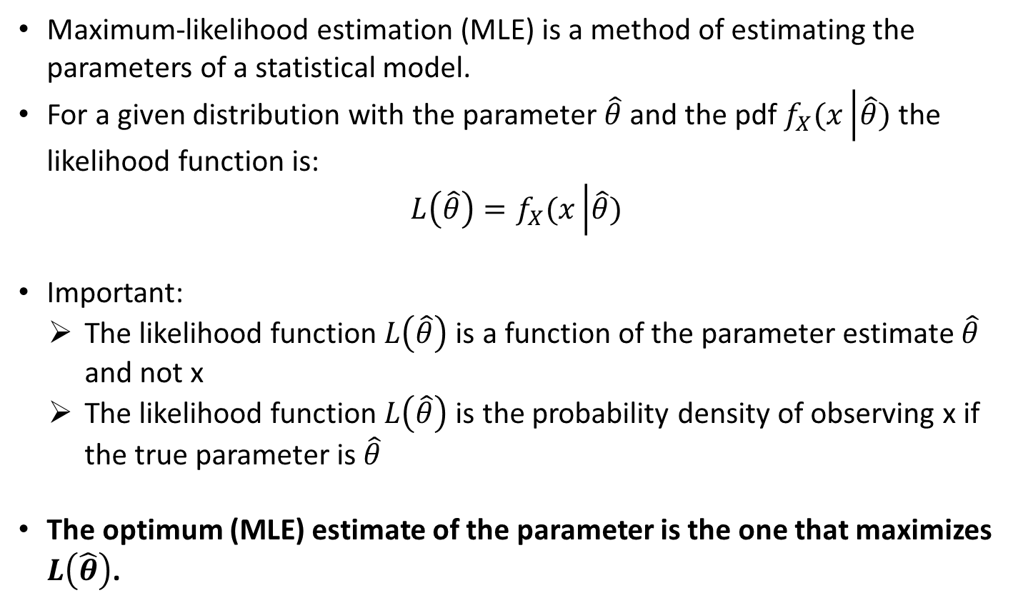
Maximum-likelihood Estimator
Maximum-likelihood estimation (MLE) is a method of estimating the parameters of a statistical model.
For a given distribution with the parameter $\hat{θ}$ and the pdf $f_{X}(x\left|\hat{θ}\right.)$ the likelihood function is:
$$L\left(\hat{θ}\right)=f_{X}(x\left|\hat{θ}\right.)$$
Important:
The likelihood function $L\left(\hat{θ}\right)$ is a function of the parameter estimate $\hat{θ}$ and not x
The likelihood function $L\left(\hat{θ}\right)$ is the probability density of observing x if the true parameter is $\hat{θ}$
The optimum (MLE) estimate of the parameter is the one that maximizes $L\left(\hat{θ}\right)$.

Slide 20
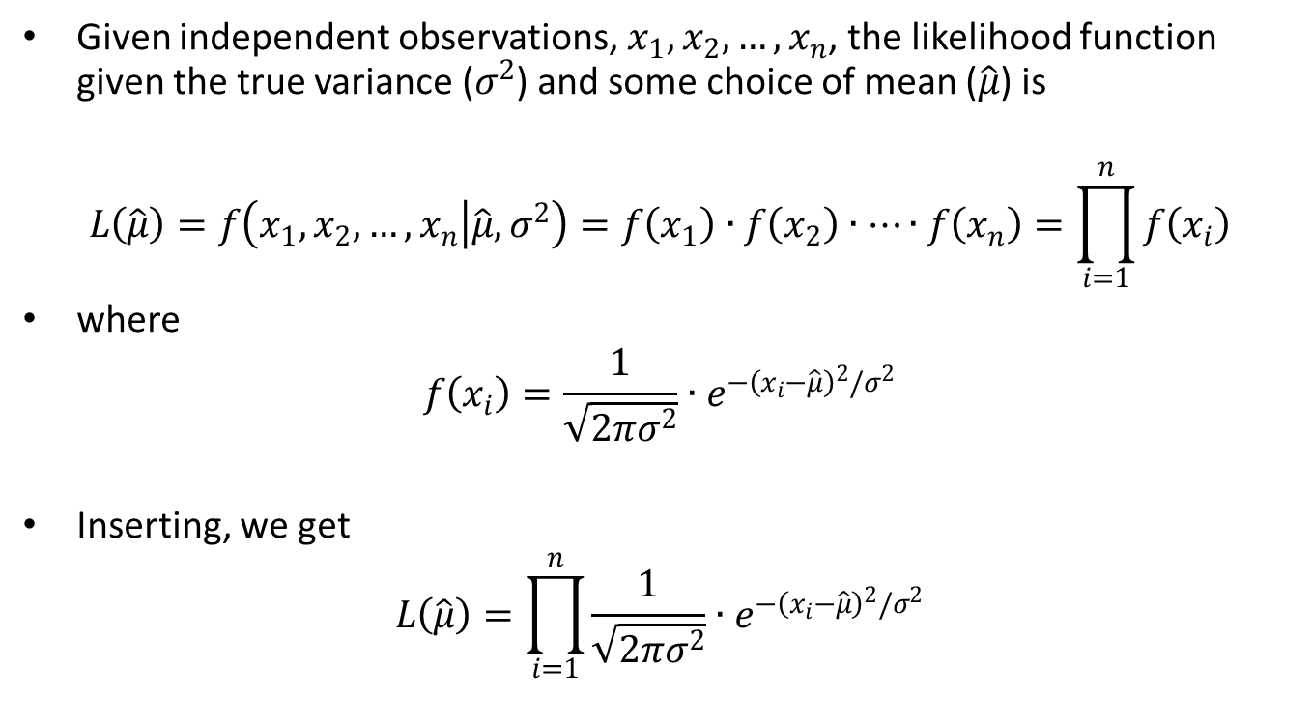
Maximum-likelihood Estimate of the Mean
Multiplication
Likelihood
i.i.d. data
in Gaussian data

Slide 21
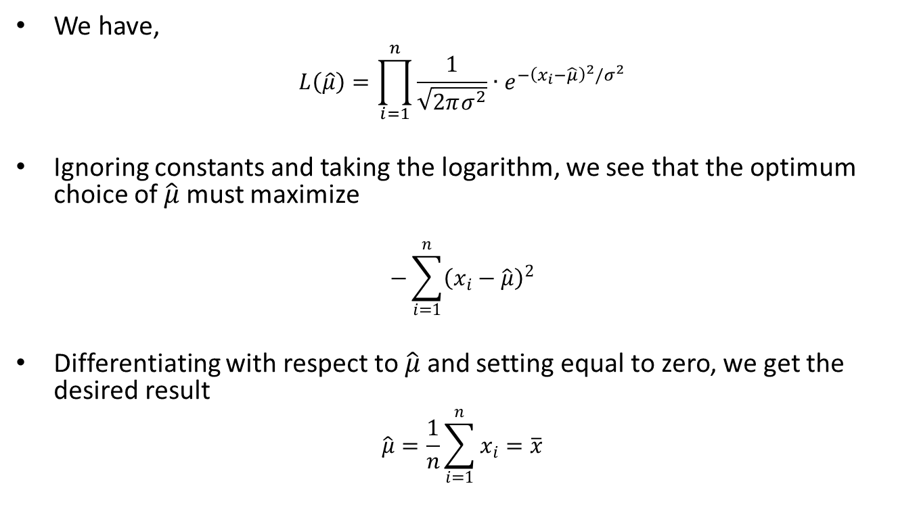
Maximum-Likelihood Estimate of the Mean
i.i.d. Gaussian data
Called: the log-likelihood

Slide 22
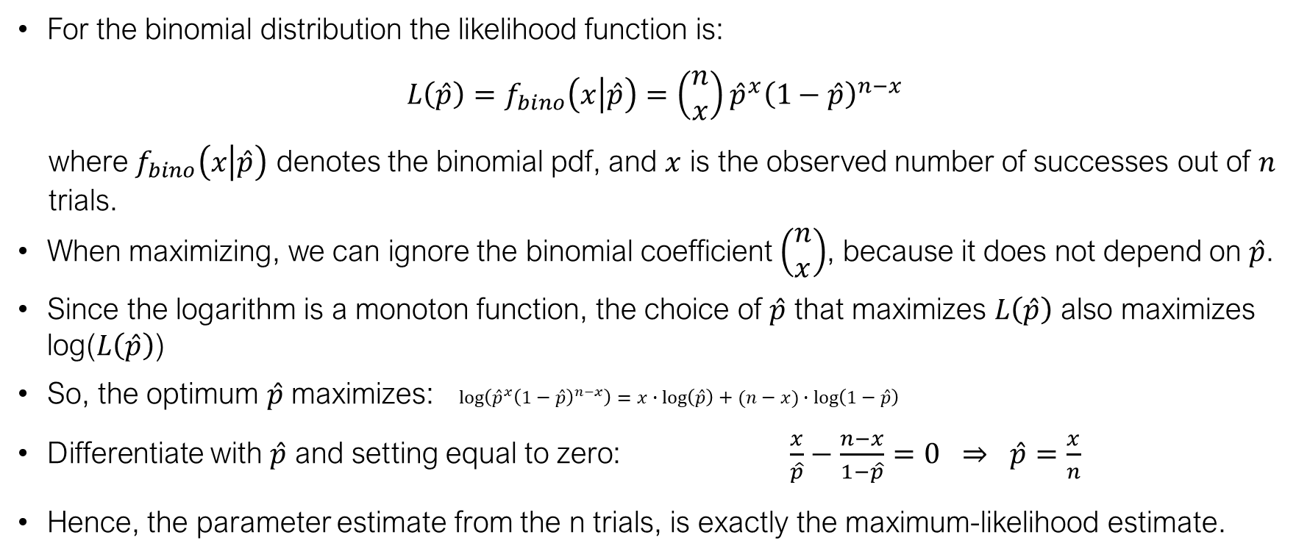
Maximum-likelihood Estimator for Binomial Data
For the binomial distribution the likelihood function is:
$$L\left(\hat{p}\right)=f_{bino}\left(x\left|\hat{p}\right.\right)=\left(\begin{matrix}n \\ x\end{matrix}\right){\hat{p}}^{x}{\left(1−\hat{p}\right)}^{n−x}$$
where $f_{bino}\left(x\left|\hat{p}\right.\right)$ denotes the binomial pdf, and $x$ is the observed number of successes out of $n$ trials.
When maximizing, we can ignore the binomial coefficient $\left(\begin{matrix}n \\ x\end{matrix}\right)$, because it does not depend on $\hat{p}$.
Since the logarithm is a monoton function, the choice of $\hat{p}$ that maximizes $L\left(\hat{p}\right)$ also maximizes log($L\left(\hat{p}\right)$)
So, the optimum $\hat{p}$ maximizes: $log\left({\hat{p}}^{x}{\left(1−\hat{p}\right)}^{n−x}\right)=x∙\log\left(\hat{p}\right)+(n−x)∙\log\left(1−\hat{p}\right)$
Differentiate with $\hat{p}$ and setting equal to zero: $\frac{x}{\hat{p}}−\frac{n−x}{1−\hat{p}}=0 ⇒ \hat{p}=\frac{x}{n}$
Hence, the parameter estimate from the n trials, is exactly the maximum-likelihood estimate.

Slide 23
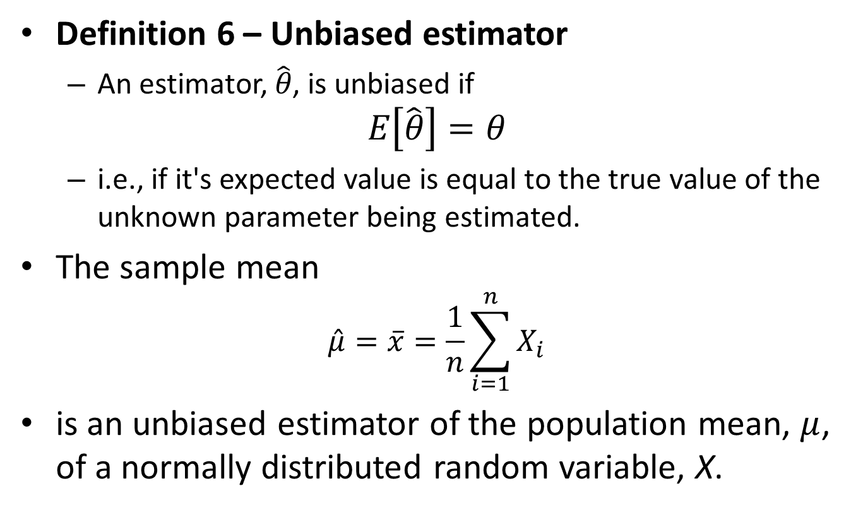
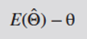
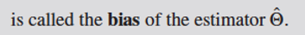

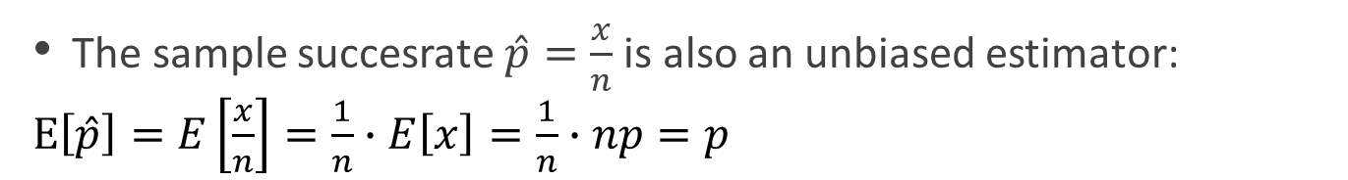
Unbiased Estimator
Key term
The sample succesrate $\hat{p}=\frac{x}{n}$ is also an unbiased estimator:
$E\left[\hat{p}\right]=E\left[\frac{x}{n}\right]=\frac{1}{n}∙E\left[x\right]=\frac{1}{n}∙np=p$

Slide 24
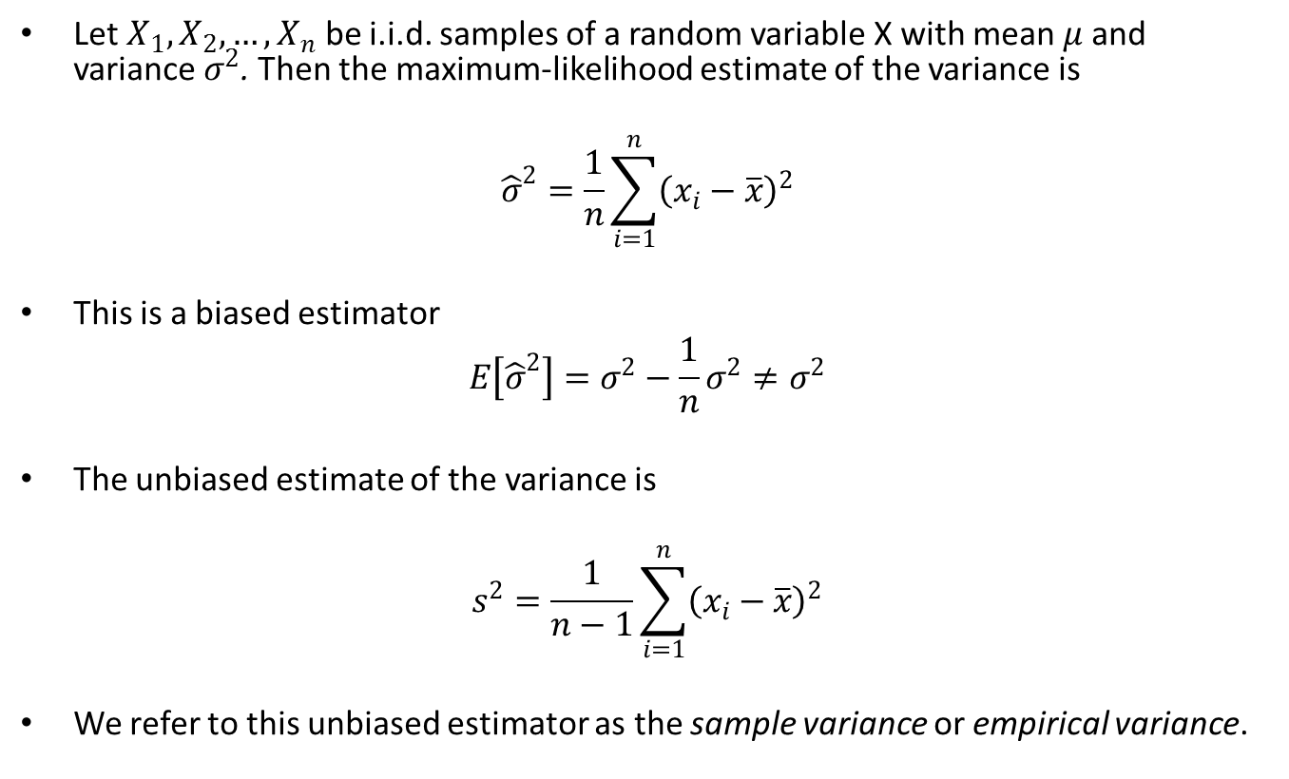
The Sample Variance
Key term
n-1 degrees of freedom

Slide 25
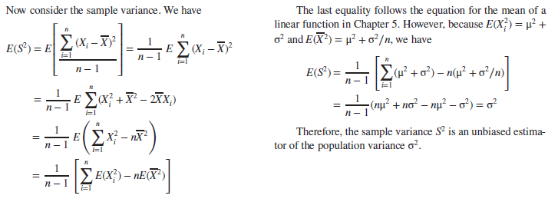
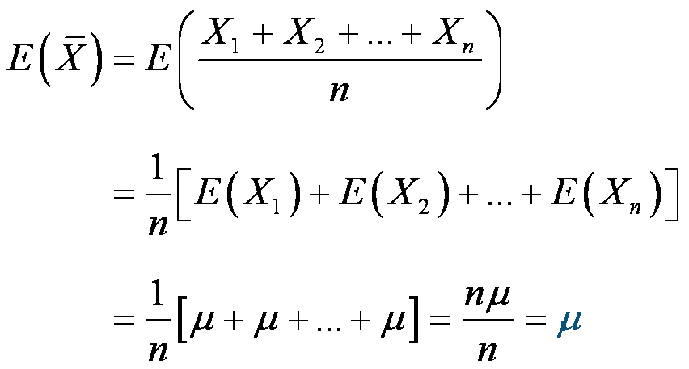
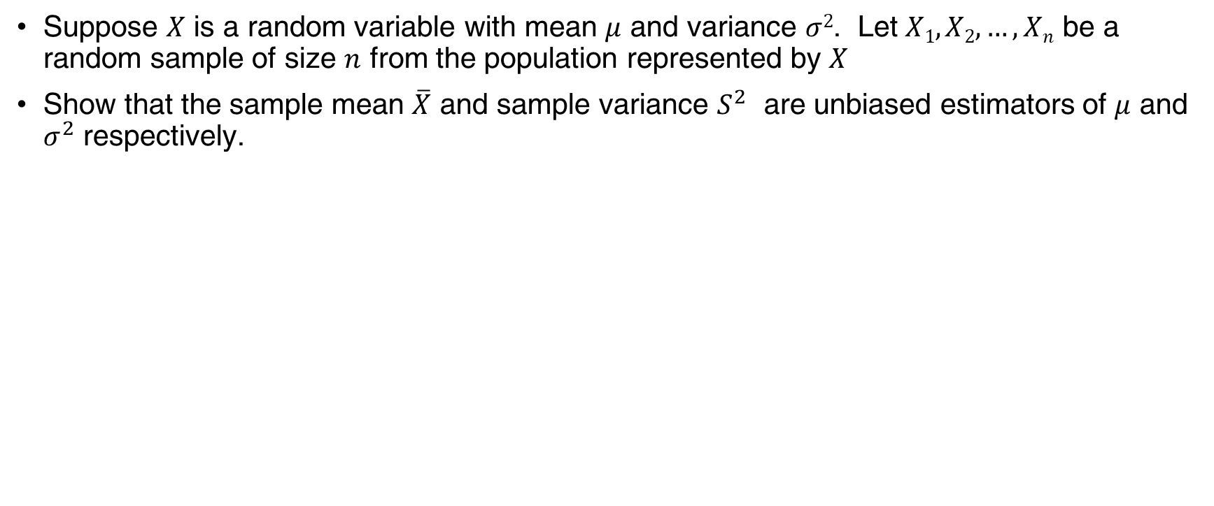
Example 7.3 | Sample Mean and Variance are Unbiased
Suppose $X$ is a random variable with mean $μ$ and variance $σ2$. Let $X1, X2,…,Xn$ be a random sample of size $n$ from the population represented by $X$
Show that the sample mean $\overline{X}$ and sample variance $S^{2}$ are unbiased estimators of $μ$ and $σ^{2}$ respectively.

Slide 26
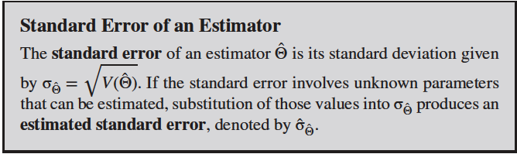
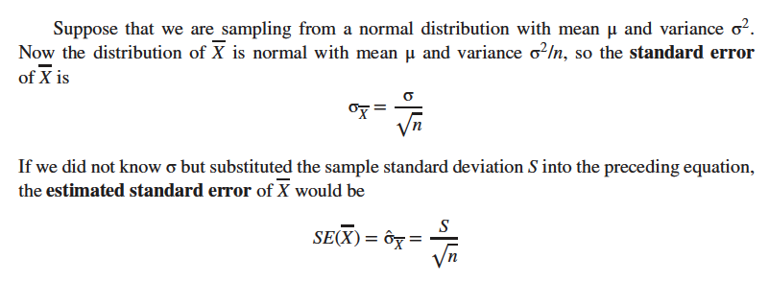
Standard Error: Reporting a Point Estimate

Slide 27
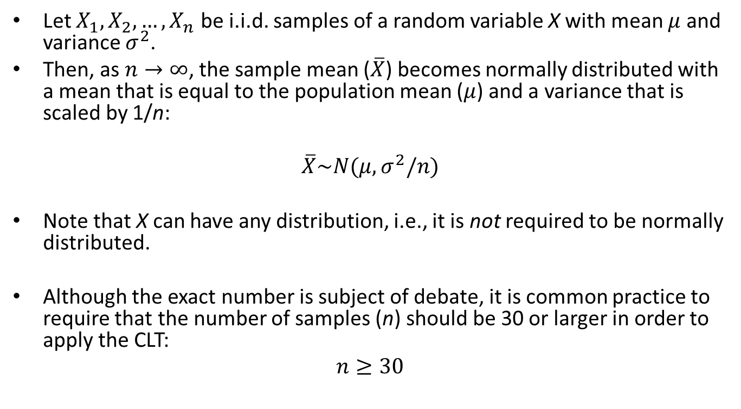
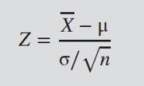

Central Limit Theorem
Sample mean
…most important number in statistics

Slide 28
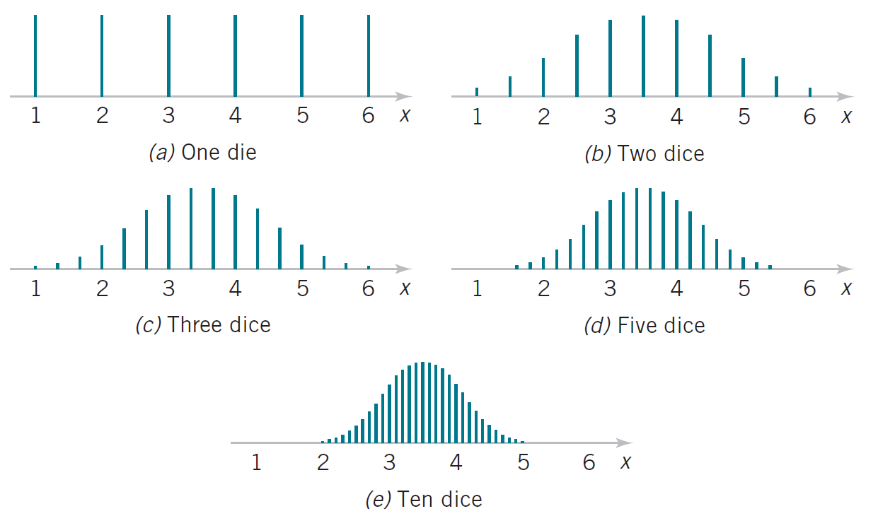
Central Limit Theorem

Slide 29
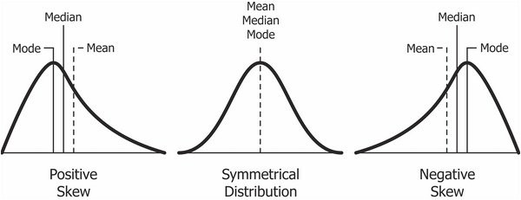
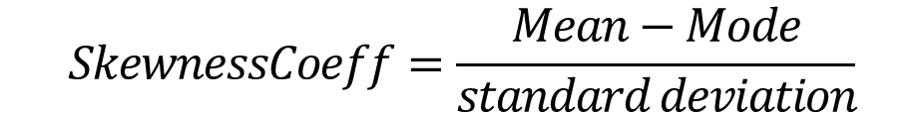
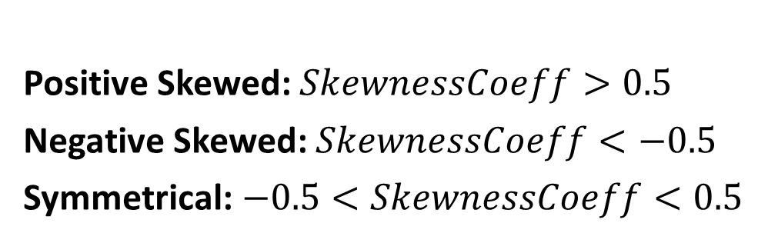
Skewness and kurtosis
Positive Skewed: $SkewnessCoeff>0.5$
Negative Skewed: $SkewnessCoeff<−0.5$
Symmetrical:$−0.5<SkewnessCoeff<0.5$
$$SkewnessCoeff=\frac{Mean−Mode}{standard deviation}$$

Slide 30
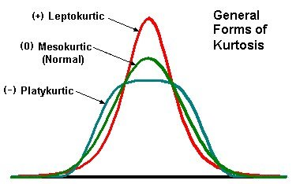
Skewness and kurtosis
Mesokurtic: -0.5 < kurtosis >0.5
Platykurtic: kurtosis < -0.5
Leptokurtic: kurtosis > 0.5

Slide 31
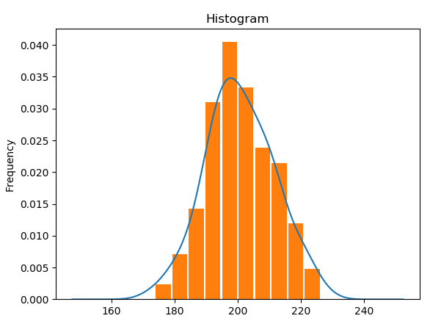
Kernel Density Estimate
A kernel density estimation (KDE) is a way to estimate the probability density function (PDF) of the random variable that “underlies” our sample. KDE is a means of data smoothing
Notes:
Import pandas as pd
fig, ax = plt.subplots()
df.plot.kde(ax=ax, legend=False, title='Histogram')
df.plot.hist(density=True, ax=ax, legend=False, rwidth=0.9)

Slide 32
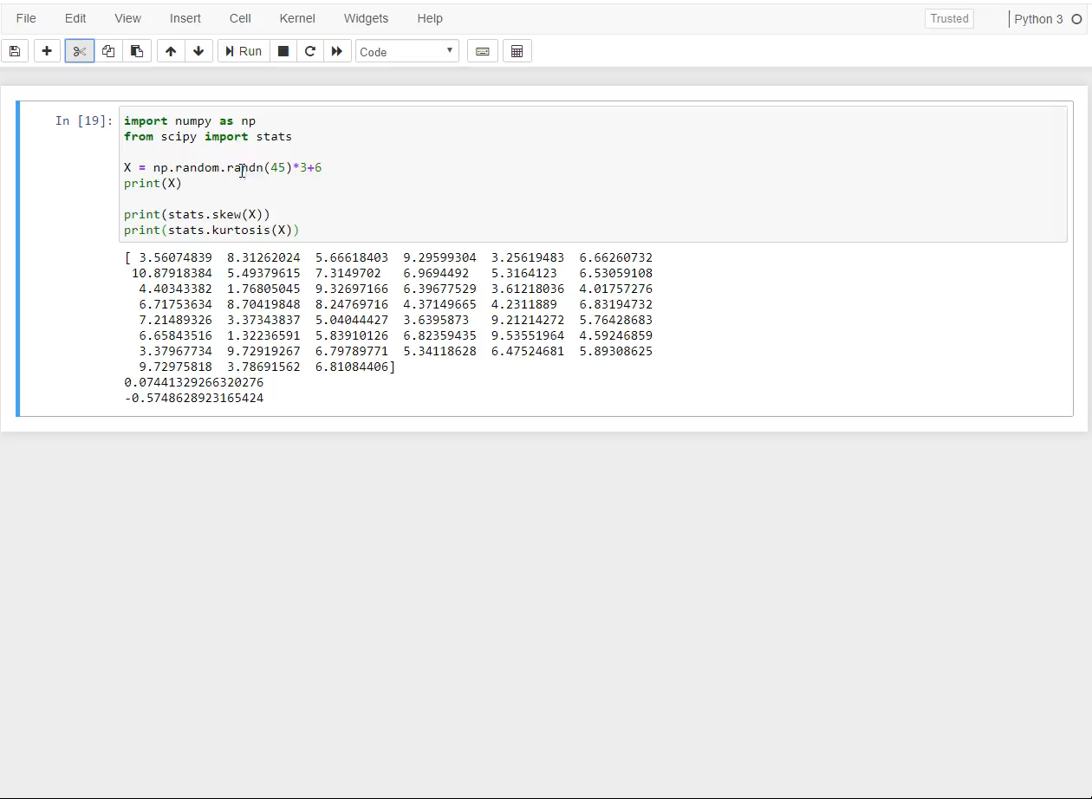

Slide 33
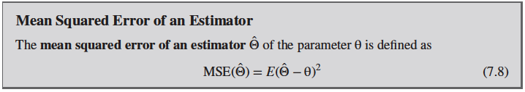
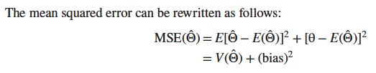
Mean Squared Error of an Estimator
The mean squared error is equal to the variance of the estimator plus the squared bias

